Slide 1
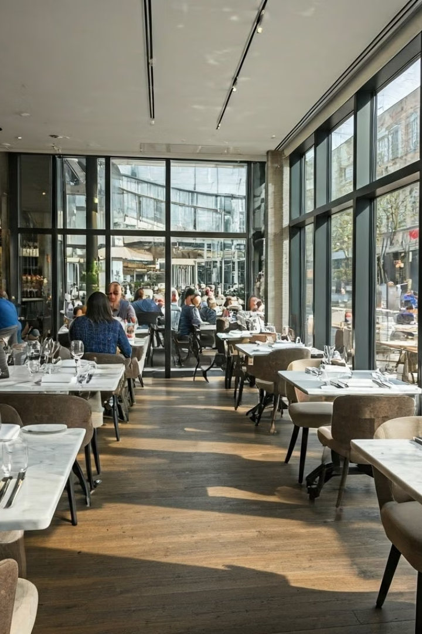


Restaurant Management System: A Java OOP Example
Welcome to this presentation showcasing a restaurant management system built using Java and object-oriented programming (OOP) concepts. This system aims to manage orders, reservations, inventory, and staff effectively, demonstrating the power of OOP principles.

Slide 2
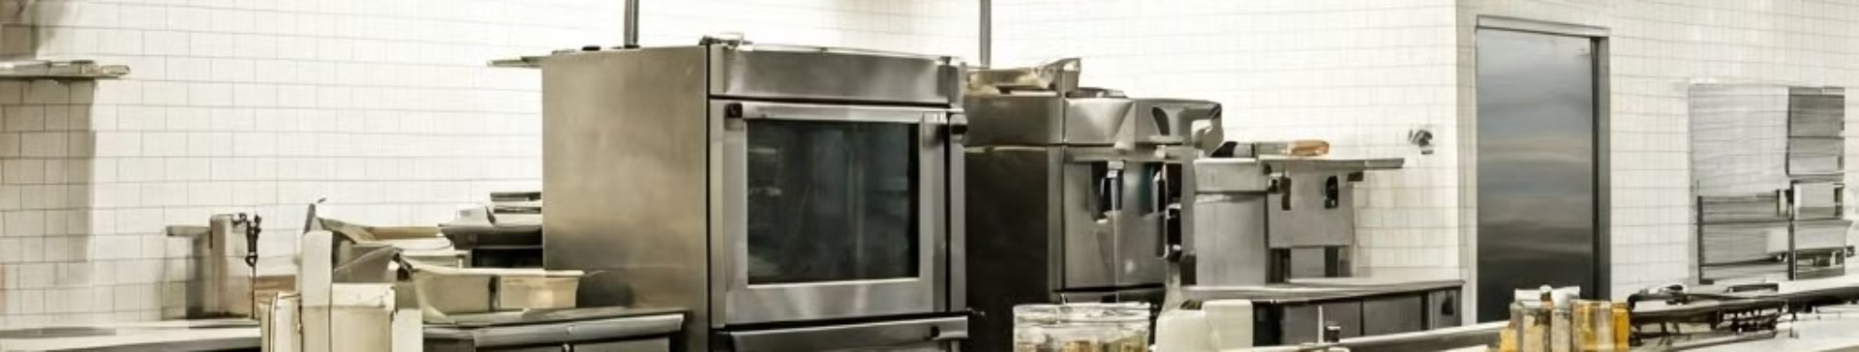

Introduction
Topic: Restaurant Management System
Objective: Efficient Management
Objective: OOP Implementation
This system focuses on streamlining operations for restaurants of all sizes.
The goal is to manage orders, tables, inventory, and staff efficiently.
This project showcases how object-oriented programming (OOP) principles can be used to build a robust and scalable restaurant management system in Java.

Slide 3


Classes Overview
MenuItem Class
Order Class
Reservation Class
Represents a menu item with name and price, essential for creating the restaurant's menu.
Manages multiple items in an order, calculates the total bill, and tracks payment details.
Handles table bookings and cancellations, managing the restaurant's seating arrangements.
InventoryItem Class
Staff Class
Tracks the available quantity of each stock item, ensuring efficient inventory management.
Stores staff details like names, roles, and contact information, facilitating staff management.

Slide 4


Workflow of the System
1
View Menu
Displays all available menu items for customers to choose from.
2
Create Order
Allows customers to add items to their order, view the bill, and select a payment method.
3
Reserve Table
Customers can book a table by entering its number, managing seating arrangements.
4
Cancel Reservation
Customers can cancel their table booking if needed.
5
Manage Inventory
Allows staff to view and update stock levels, ensuring sufficient ingredients.
6
Manage Staff
Provides tools for viewing and adding staff members, facilitating workforce management.

Slide 5


Code Structure: Modular Design
Menu Management
Order Processing
Table Reservations
Inventory Management
This module defines and handles menu items, including their names, descriptions, and prices. It allows for adding, removing, and updating menu items, ensuring the restaurant offers a comprehensive and up-to-date menu.
This module handles the creation, storage, and calculation of customer orders. It allows for adding items, calculating the total bill, and processing payments. It also manages order details like order number, date, and time.
This module manages table bookings and cancellations, ensuring efficient seating arrangements. It tracks table availability, reservation details, and customer contact information.
This module tracks available stock items and their quantities. It helps manage inventory levels, monitors stock expiration dates, and facilitates replenishing orders. It also provides insights into inventory trends and potential shortages.

Slide 6
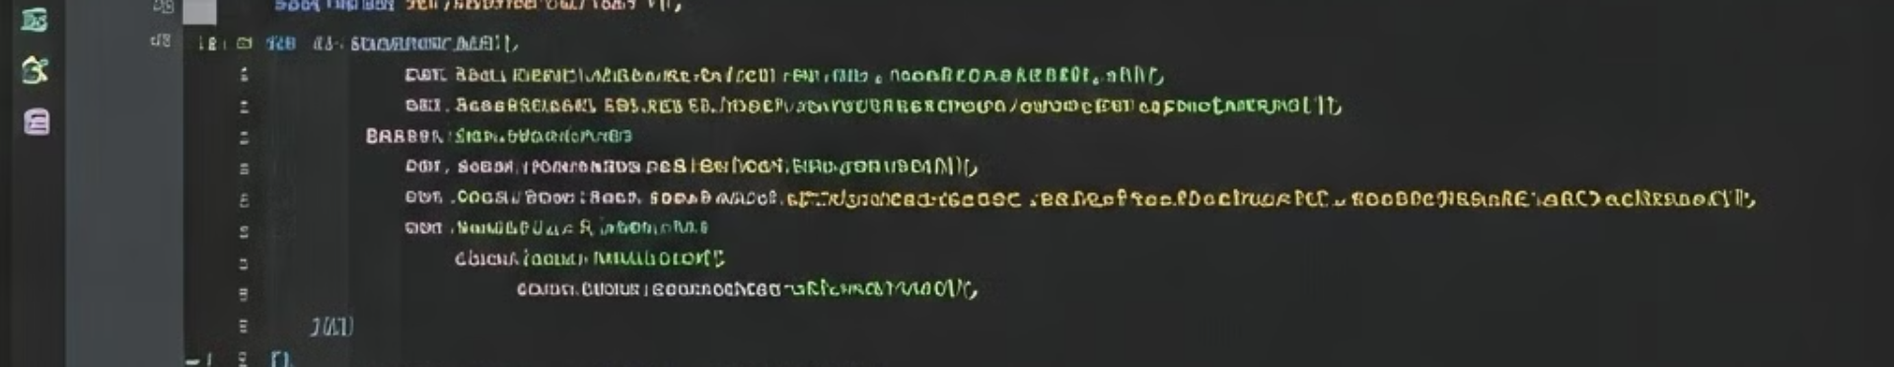


Sample Code Snippet
1
2
3
Order Creation
Item Addition
Order Display
A new Order object is created, initializing an empty order ready to be filled with items.
The addItem method adds a new MenuItem to the order, in this case, a "Pizza" item priced at 250.
The viewOrder method displays the current items in the order, including their names and prices, providing a summary of the customer's choices.

Slide 7
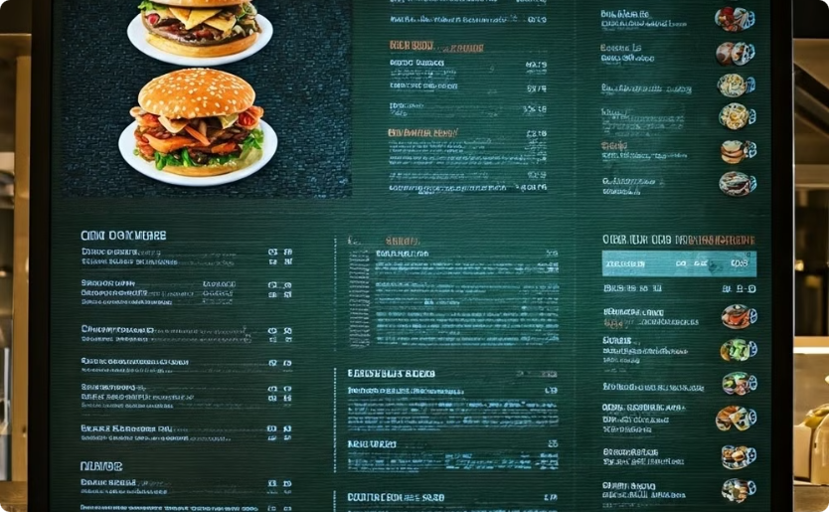
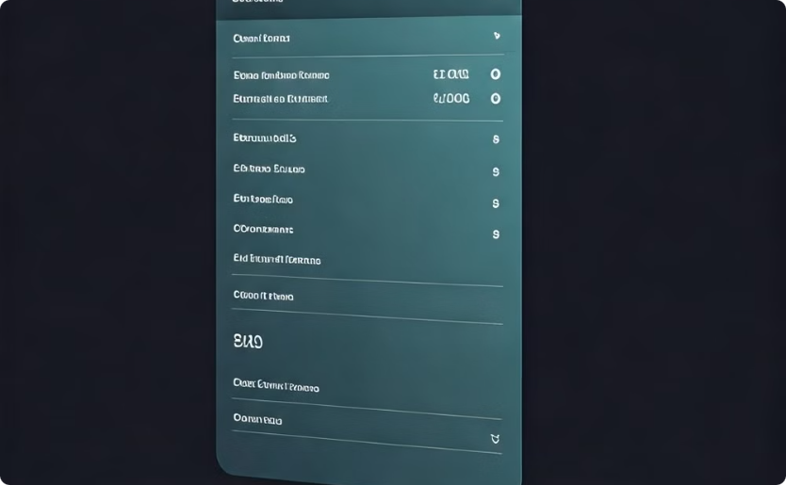


Example Execution Output
Menu
Order Summary
The menu displays a list of available items with their corresponding prices, providing customers with a clear selection.
The order summary presents the items selected by the customer, calculates the total amount, and confirms the chosen payment method.

Slide 8




Conclusion
OOP Implementation
Restaurant Efficiency
Scalability and Adaptability
The restaurant management system demonstrates how object-oriented programming (OOP) concepts like classes, objects, inheritance, and polymorphism can be applied effectively in real-world applications.
The system helps manage all aspects of restaurant operations, from menu planning and inventory management to order processing, reservations, and staff scheduling.
The use of OOP principles makes the system highly scalable and adaptable, allowing for easy expansion with additional features and functionalities as needed.

